Slide 1
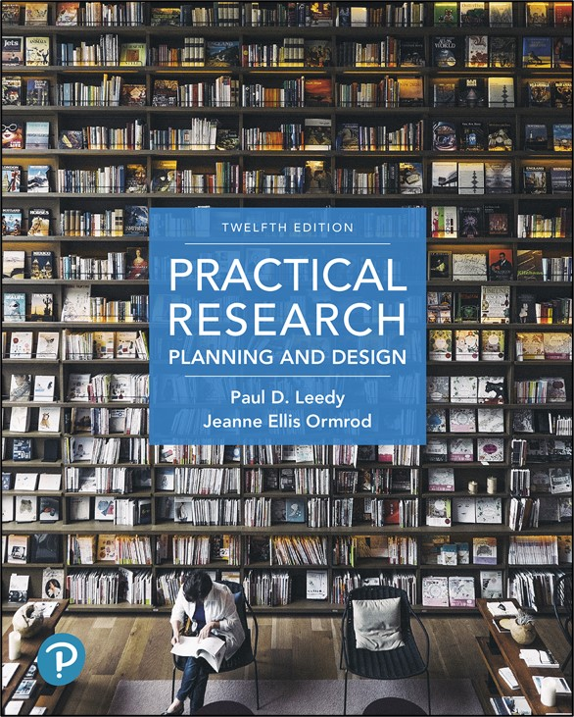
Practical Research: Planning and Design
Twelfth Edition
Chapter 9
Mixed Methods Designs
Copyright © 2019, 2016, 2013 Pearson Education, Inc. All Rights Reserved
Notes:
If this PowerPoint presentation contains mathematical equations, you may need to check that your computer has the following installed:
1) Math Type Plugin
2) Math Player (free versions available)
3) NVDA Reader (free versions available)

Slide 2
Mixed Methods Designs (1 of 3)
Integration of quantitative and qualitative data
Most useful when addressing the research problem requires both types of data

Slide 3
Mixed Methods Designs (2 of 3)
Mixed Methods Researchers should be well-versed in:
Identifying focused and useful research questions
Formulating and strategically testing hypotheses
Choosing one or more samples that enable appropriate inferences about a larger population
Controlling for confounding variables
Creating and using assessment instruments that have validity and reliability for their purposes

Slide 4
Mixed Methods Designs (3 of 3)
Mixed Methods Researchers should be well-versed in:
Conducting structured, semistructured, and open-ended interviews
Analyzing qualitative data
Calculating and drawing inferences from descriptive and inferential statistics
Drawing and persuasively arguing for reasonable conclusions from qualitative data

Slide 5
When Mixed-Methods Designs are Most Useful and Appropriate
Several good reasons for mixed methods research:
Completeness
Complementarity
Hypothesis generation and testing
Development of appropriate research tools and strategies
Resolution of puzzling findings
Triangulation

Slide 6
General Categories of Mixed-Methods Research (1 of 4)
Convergent designs
Qualitative and quantitative data collected together, equally weighted
Often take a Q U A NTITATIVE + Q U A LITATIVE form
Can also take an approach that more heavily favors either quantitative or qualitative

Slide 7
General Categories of Mixed-Methods Research (2 of 4)
Exploratory sequential designs
Qualitative phase to get a general sense of the phenomenon first
More systematic, quantitative phase based on qualitative data
Explanatory sequential designs
Quantitative phase first
Qualitative phase for exploration of quantitative results

Slide 8
General Categories of Mixed-Methods Research (3 of 4)
Longitudinal Mixed-Methods Designs
Longitudinal studies (recall from chapter 6) follow a single group of participants for two or more occasions over a lengthy time period, perhaps over the course of several months or years.
Longitudinal mixed-methods designs incorporate both qualitative and quantitative data collection over a long period of time.

Slide 9
General Categories of Mixed-Methods Research (4 of 4)
Multiphase iterative designs
Three or more phases
Foundational data early
Later phases build on early data
Example: Program evaluation
Baseline data
Intervention
Data: Did the intervention work
Modify the intervention
Data: Did the modifications work

Slide 10
Planning a Mixed-Methods Study (1 of 2)
Identify research questions and hypotheses
should require different types of data
Begin a literature review
May require revision and additions as the study emerges
Choose appropriate samples
Independent
Linked

Slide 11
Planning a Mixed-Methods Study (2 of 2)
Ensure credibility of the overall research effort
Consider special ethical issues
may need more than one institutional review
may need to ensure consent for follow-up phases

Slide 12
Analyzing and Interpreting Mixed-Methods Data
Two important considerations:
How to weight quantitative and qualitative data when drawing conclusions
How to integrate quantitative and qualitative findings for interpretation

Slide 13

Copyright
This work is protected by United States copyright laws and is provided solely for the use of instructors in teaching their courses and assessing student learning. Dissemination or sale of any part of this work (including on the World Wide Web) will destroy the integrity of the work and is not permitted. The work and materials from it should never be made available to students except by instructors using the accompanying text in their classes. All recipients of this work are expected to abide by these restrictions and to honor the intended pedagogical purposes and the needs of other instructors who rely on these materials.

